Slide 1
Computer Security Threats

Slide 2
Computer Security Concepts,
Threats,
Attacks,
Assets,
Intruders
Malware and Its Impact on System Security
Social Engineering and Human-Centric Threats
Insider Threats and Organizational Risks

Slide 3
Computer Security
Computer security means protect our computing system

Slide 4
Main aspects are:
Prevention:- Prevent your assets from being damaged
Detection :- Detect when assets has been damage
Reaction:- Recover your assets
Computer Security: - Ensuring the data stored in a computer cannot be read or compromised by an individual‘s without authorization.
Most computer security measures involve data encryption and passwords.

Slide 5
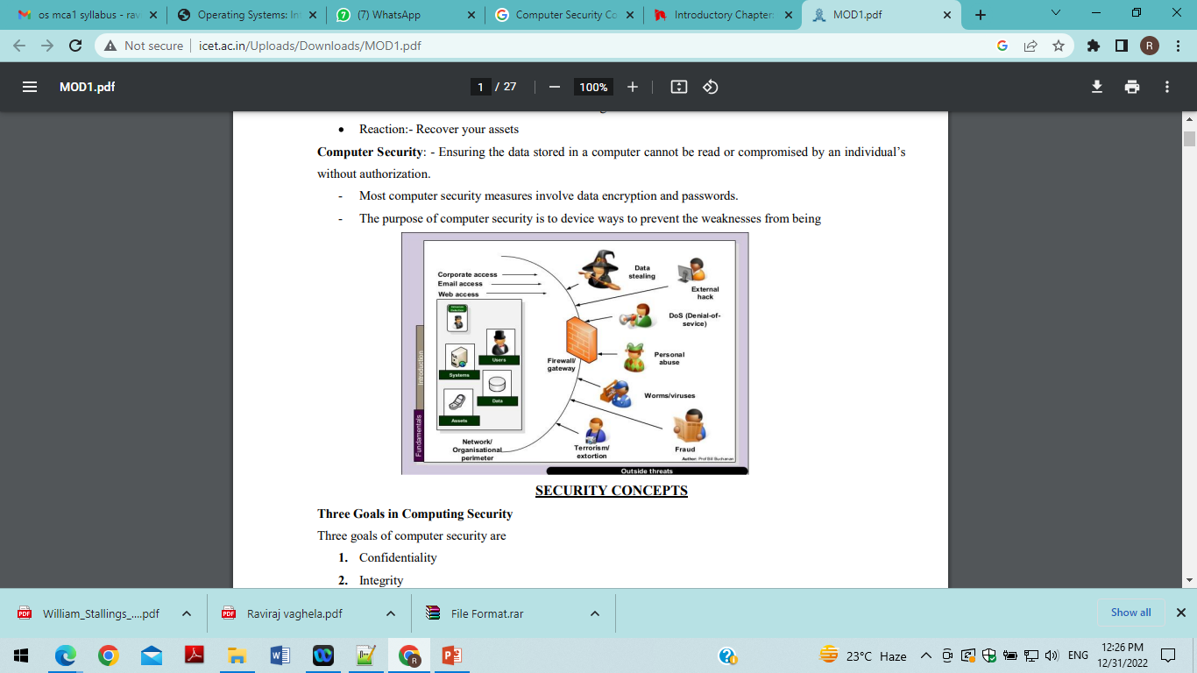
Computer Security
The purpose of computer security is to device ways to prevent the weaknesses from being.

Slide 6
Three Goals in Computing Security
Three goals of computer security are 1. Confidentiality 2. Integrity 3. Availability

Slide 7
Security
confidentiality
Integrity
Availability
Confidentiality

Slide 8
Why is computer security important?
Computer security is important, primarily to keep your information protected. It‘s also important for your computer‘s overall health, helping to prevent viruses and malware and allowing programs to run more smoothly. Security is needed due to following reason.
1.Privacy:- It defines the right of individuals to hold information about themselves in secret, free from the knowledge of others
2. Accuracy: - Most of damages of data is caused by errors and omissions. An organization always needs accurate data for transaction processing, providing better service and making
3. Threats by dishonest employ
4. Computer Crimes:- When computer resources can be misused for unauthorized or illegal function
5. Threats for fire and Natural Disasters:- fire and natural disasters like floods, storms, lightening etc

Slide 9
THREATS
A threat to a computing system is a set of circumstances that has the potential to cause loss or harm.
A threat can be an object or person or other entity that represents a constant danger to an asset.
There are many threats to a computer system, including human-initiated and computer- initiated ones.
A threat is blocked by control of vulnerability (Weakness of the system).

Slide 10
We can view any threat as being one of four
•An interception means that some unauthorized party has gained access to an asset. The outside party can be a person, a program, or a computing system.
In an interruption is an asset of the system becomes lost, unavailable, or unusable.
If an unauthorized party not only accesses but tampers with an asset, is called as a modification.
An unauthorized party might create a fabrication of counterfeit objects on a computing system.
The intruder may insert spurious transactions to a network communication system or add records to an existing database.

Slide 11
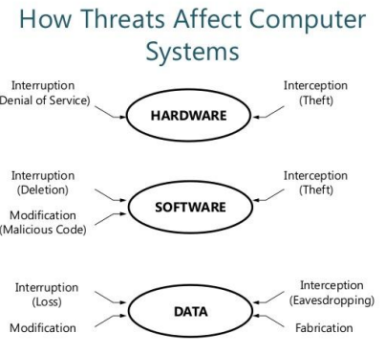

Slide 12
Kinds of threats

Slide 13
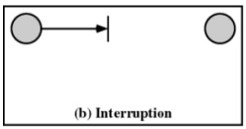
Interruption -
An asset of the system is destroyed of becomes unavailable or unusable
– Attack on availability
- Destruction of hardware
– Cutting of a communication line
– Disabling the file management system

Slide 14
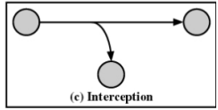
Interception
-An unauthorized party gains access to an asset
– Attack on confidentiality
– Wiretapping to capture data in a network
– Illicit copying of files or programs
There is a middleman or process or machine trying to intercept

Slide 15
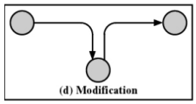
Modification
An unauthorized party not only gains access but tampers with an asset
– Attack on integrity
– Changing values in a data file
– Altering a program so that it performs differently
– Modifying the content of messages being transmitted in a network
Here middleman changes the data and send to the receiver

Slide 16
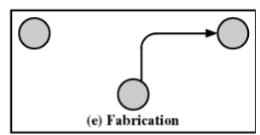
Fabrication
--An unauthorized party inserts counterfeit objects into the system
– Attack on authenticity
– Insertion of spurious messages in a network
– Addition of records to a file
Here sender not sends data to the receiver. Middleman fabricate the data

Slide 17
ATTACKS
Attack is the process of gaining the access of data by unauthorized user.
It is an Act or attack that exploit vulnerability(Weakness of the system)

Slide 18
What does Attack mean?
An attack is an information security threat that involves an attempt to obtain, alter, destroy, remove, implant or reveal information without authorized access or permission. It happens to both individuals and organizations.
Two types of attacks are.
1. Passive attack:-data just accessed by third party, no modification, does not affect system resources
2. Active attack:- data will be modified

Slide 19
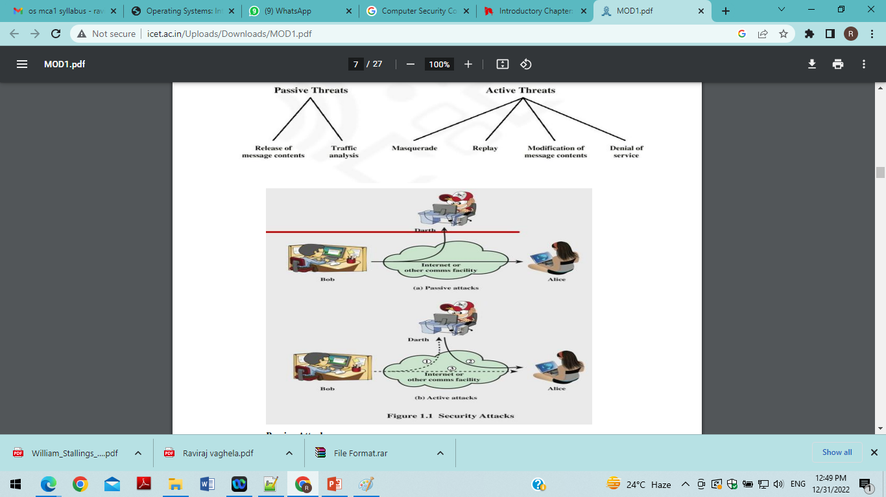

Slide 20
Passive Attacks:
-Release of message contents for a telephone conversion, an electronic mail message, and a transferred file are subject to these threats
– Traffic analysis:- By analyzing the traffic flow between sender and receiver third party access the data

Slide 21
Active Attacks
Masquerade takes place when one entity pretends to be a different entity
– Replay involves the passive capture of a data unit and its subsequent retransmission to produce an unauthorized effect
– Modification of messages means that some portion of a legitimate message is altered, or that messages are delayed or reordered, to produce an unauthorized effect
– Denial of service prevents or inhibits the normal use or management of communications facilities
• Disable network or overload it with messages

Slide 22
Intruders
Intruders are the attackers who attempt to breach the security of a network. They attack the network in order to get unauthorized access.
Intruders are of three types, namely, masquerader, misfeasor and clandestine user
Masquerader: are outsiders and hence they don't have direct access to the system, their aim is to attack unethically to steal data/ information.
Misfeasor :The category of individuals that are authorized to use the system, but misuse the granted access and privilege.
clandestine :The category of individuals those have supervision/administrative control over the system and misuse the authoritative power

Slide 23
Malware and Its Impact on System Security
Malware (malicious software) refers to any program intentionally designed to cause damage, unauthorized access, or disruption to a computer system. Common types include viruses, worms, Trojans, spyware, and ransomware.
Viruses attach themselves to legitimate programs and spread when those programs run.
Worms spread automatically across networks, exploiting system vulnerabilities.
Trojans disguise themselves as useful software but secretly perform harmful actions such as stealing data.
Ransomware encrypts user data and demands payment for decryption.

Slide 24
The impact of malware can range from slowing down system performance to complete data loss or financial theft. Organizations must implement strong controls such as antivirus software, timely patching, and user awareness programs to minimize the risk of infection.

Slide 25
Social Engineering and Human-Centric Threats
Social engineering attacks manipulate human psychology rather than exploiting technical vulnerabilities. Attackers trick users into revealing sensitive information or performing actions that compromise system security. Common techniques include:
Phishing: Fake emails or websites that appear legitimate, designed to steal passwords or financial details.
Pretexting: Attackers create a fabricated scenario to obtain confidential data—for example, pretending to be technical support.
Baiting: Offering something appealing (like a free USB drive) to lure users into installing malicious software.
Since humans are often the weakest link in security, training, awareness, and verification procedures are essential for preventing manipulation.

Slide 26
Insider Threats and Organizational Risks
An insider threat occurs when an individual within the organization intentionally or unintentionally compromises security. Insiders may include disgruntled employees, contractors, or even system administrators with privileged access. Forms of insider threats:
Intentional misuse (similar to misfeasors): accessing data beyond assigned roles for personal gain or sabotage.
Negligence: careless actions such as weak passwords, improper data handling, or clicking on suspicious links.
Privilege abuse: administrators or supervisory users bypassing controls for unauthorized activities.
To mitigate insider threats, organizations implement role-based access control, monitoring systems, periodic audits, and strong policies regarding data handling.

